Slide 1
MTCHacks 2
Who is ANN?
By: Sashank Shyam

Slide 2

Signposts
Most Fundamental Aspect
Through the Ages
Sponge 2.0 Network
Neuron
Layer
Model
Neural Networks Today:
Types
Usage
Further Material:
YouTube
Websites
Papers

Slide 3

Get your Mind in Gear
Pattern recognition
Enact a model
Normalize the model
Improve the model
Star anew
Notes:
For the few who actually visit these slides again:
Neural networks problems nearly always require the following mindset. Pattern Recognition, Model Creation, Continuous Improvement, Repetition.
The above is a general rule of thumb.

Slide 4

Back to the Future
1950s - 1970s:
“No Machine could ever do X!”
1970s - 1980s:
Expert Systems
GOFAI (Good Old Fashioned Artificial Intelligence)
1980s – 1990s:
AI winter
Notes:
The initial paradigms as data science and Artificial Intelligence was showing prominence were generally if AI could beat humans at x problem
Chess was one of the first problems explored. Can we make an AI to beat the chess grand master.
The older paradigms consisted of stuff that lasted towards the end of today but generally was in it’s hayday from 1950s to the 1970s.
For more info on this paradigm check on John McCarthy and Dartmouth Summer Project of 1956
From the 1970s till the 80s we saw a rise in expert systems
These are systems designed to aid in decision making. Stuff like the Space Shuttle Mission Control.
These systems were mainly used to supplant human decision making they often times failed howver due to their scope and technological limitation
For more info on this paradigm check on Japan’s Fifth-Generation Computer Systems project or Stanford Heuristic Programming Project by Edward Feignbaum
From the 1980s till the 90s
Had a short AI winter
Basically tech was playing catchup to software (risc, x64 over x32 etc)

Slide 5
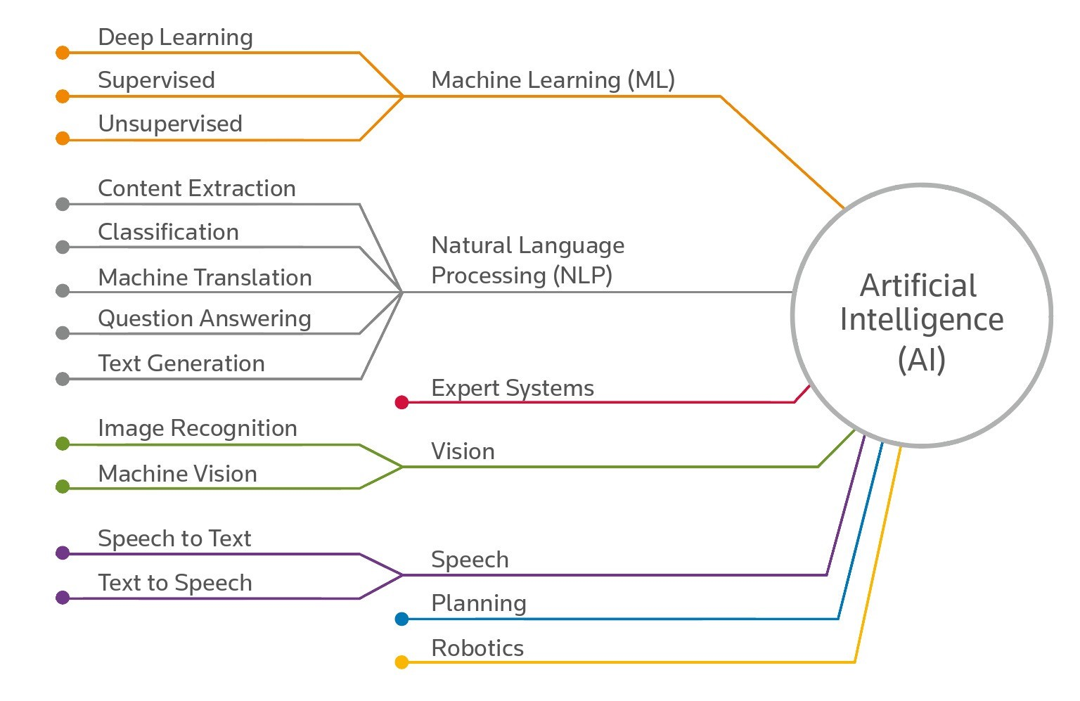
Today’s Paradigms
1990s – 2010:
Neural Networks
Connectionism Resurgence
2010 – Present:
Problem Specific
Umbrella based
Notes:
Moving closer to the modern era we see the appearance of Neural Networks and Connectionism in the 90s.
These are basically precursors of what you see in use today.
Neural networks are basically modelling brain synapse like connections to process decision making
Connectionism is basically the belief that using neural networks yields results akin to human decision making
The latest in AI mirrors the image here:
AI encompasses a vast amount of topics and fields
As you can see there are multiple sub fields

Slide 6

What is it?
Beat it/ Help it
Is HAL Artificial Intelligence?
Distinguishing AI
Decision Making
Notes:
Previous pardigms were beat it or help it. Now they are both? We currently focus on replacing and helping humans
So does this mean that anything that helps or replaces humans is AI?
AI today could mean multilayer if else → recurrent neural network with dream sequence
Intelligence is taking in multiple sensory inputs and finally coming up with a decision based on said inputs (not necessarily rational)
What makes intelligence different is the non determined nature of the decision.
Instead of fixed pathways, information is acquired then applied.

Slide 7

Questions

Slide 8
M. L.

Slide 9

Sponge 2.0 Network
Neurons
Layers
Model
Notes:
Nearly every living thing has a brain
Sponges have no brains
Hence our sponge 2.0
A few neuron owning sponge

Slide 10
Neurons
Notes:
Neurons are the backbone of every neural network
They are your point of entry and exit for any data inputted into your network
Neurons contain “bias” values which change the input of your data

Slide 11
Layers
Notes:
Layers are basically Mulitple neurons in a row.
Each “layer” of neuron serves to modify the data in some way to further classify the data
Keep in mind each neuron in the layer can hold different bias’ therefore change the data in different increments every time

Slide 12
Realized Model
Notes:
Each dash is a connection between nodes.
Each connection once again has weights to distinguish the data

Slide 13
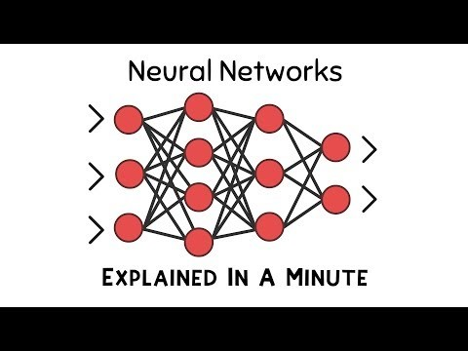
Sponge 2.0 Simple Explanation

Slide 14
Questions

Slide 15

Classification of Neural Networks
Data Classification Models:
Supervised
Unsupervised
Types of Neural Networks:
Perceptron
Feed Forward
Convolutional
Recurrent
Generative Adversarial Network

Slide 16
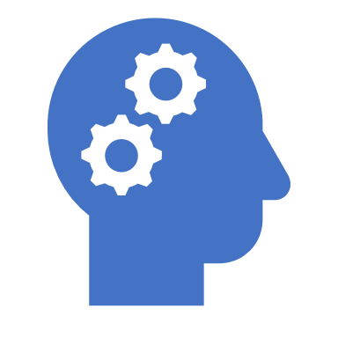
Supervised
STDIO
Hi my name is Sule and I am a hoarder
Inductive Bias
Concept Learning
Notes:
Supervised learning functions in a standard input output methodology.
The neural net gets a bunch of inputs that are already clearly defined outputs as well
So basically we feed it a bunch of answers to the test before it even needs to take one
Which is why it is also commonly referred to as the data hoarding method. Each classified input is stored and used to help train the model.
In order to develop the model dynamically, a algorithmic concept called inductive bias is used.
Inductive bias helps translates new inputs (not the already hoarded ones) into proper outputs
For more on inductive bias refer to http://citeseerx.ist.psu.edu/viewdoc/summary?doi=10.1.1.19.5466
So in general supervised learning is similar to concept learning in humans → learn rules and generalizations → categorize

Slide 17
Realized Model
Birds that take the train
Not birds that take the train
Notes:
So here is an example used in the workshop to explain the way Supervised learning works
We feed the model inputs of different birds that take the train and the opposite
But we clearly define them as such
Thus the model develops it’s own weights for what should be a bird that takes the train
And what isn’t a bird that takes the train
Another example of supervised learning we saw briefly in the workshop: https://github.com/Sentdex/pygta5

Slide 18
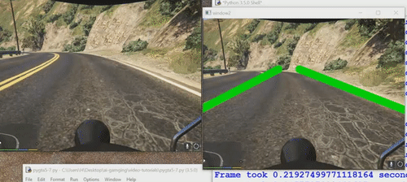
pyGTA5

Slide 19

Unsupervised
Freedom
Unhampered
Self-Organization
Autonomous Development
Hebbian Learning
Notes:
Unsupervised learning is the complete opposite of supervised learning as the name suggests
the method of training the neural network model in unsupervised learning is usually cluster analysis
So each new piece of data that enters the model is treated differently
The algorithmic concept that is systemic to unsupervised learning is Hebbian learning
To put in simple terms Hebbian learning is neurons that fire together wire together.
So data put into the model would

Slide 20
Realized Model
Thing A
Birds that take the train
Thing B
Not birds that take the train
Notes:
Now for unsupervised learning, the labels don’t apply as well
Since the distinction is done by the neural network itself, the categories could be created dynamically –on runtime/while the network is running
It could also create it’s own exclusion criteria to determine object classification so the types of outputs may not even be recognizable
Examples of unsupervised networks is the cancer recognition models being developed by IBM using Watson and Active Suspension in vehicles today

Slide 21

Active Suspension

Slide 22


Slide 23
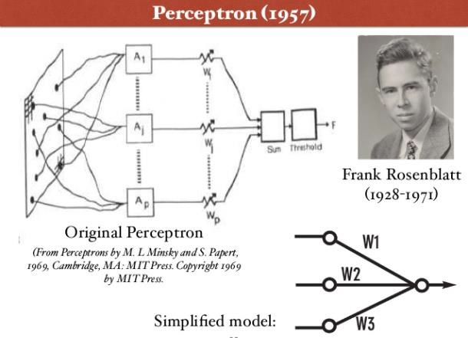
Perceptron
Used usually as a Supervised Learning Model
Weights are automatically learned
Simplest model
Notes:
https://www.youtube.com/watch?v=qv6UVOQ0F44

Slide 24
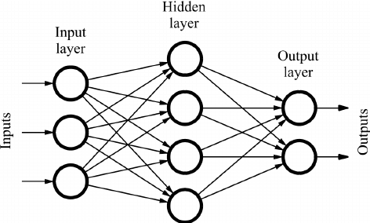
Feed Forward
No cycles
First Neural Network to be developed
Another really simple network

Slide 25
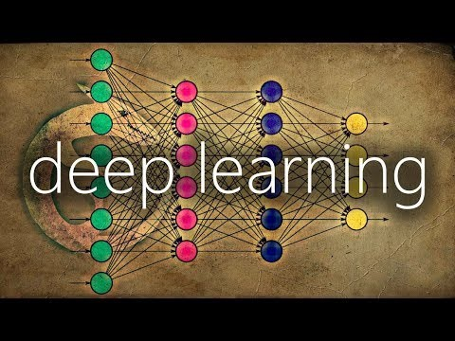
Convolutional

Slide 26
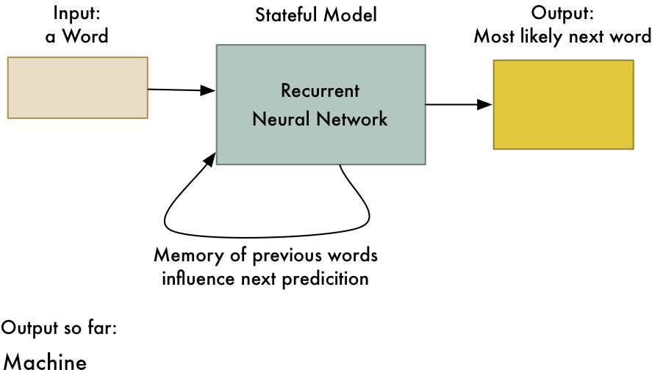
Recurrent
Speech or Handwriting recognition
Internal memory used to create prediction
Examples:
Google Voice Search
Machine Translation

Slide 27
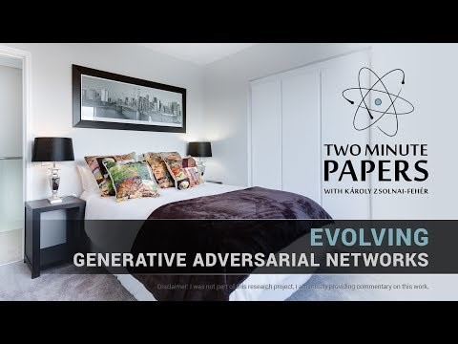
Generative Adversarial Networks

Slide 28
Questions

Slide 29

Further Material – Video Channels
2minutepapers
Tanmay Bakshi
Sentdex
3Blue1Brown

Slide 30

Further Material - Reading
Ethics and Concept books:
Superintelligence by Nick Bostrom
Life 3.0 by Max Tegmmark
Websites:
https://www.nvidia.com/en-us/deep-learning-ai/
http://deeplearning.net/tutorial/gettingstarted.html#gettingstarted
Building simple model:
Neural Networks: A Visual Introduction for Beginners
https://www.amazon.com/Hands-Machine-Learning-Scikit-Learn-TensorFlow/dp/1491962291/ref=zg_bs_3887_4?_encoding=UTF8&psc=1&refRID=6N6YVS6HD114Z3SVSKSG

Slide 31

Further Material - Papers

Slide 32
Questions

